Slide 1
BOOX
Raheel Jooma, Charlotte Owen, Abele Amsalu, Jonny Martinez, Camille Pascua

Slide 2
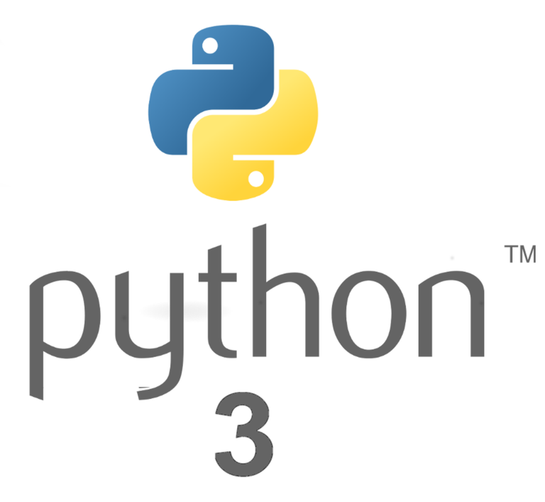

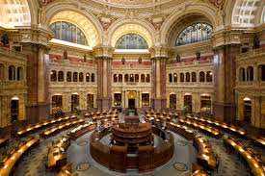
Project Overview
Website that allows users to search for non copyrighted images in the Library of Congress or Pixabay through tags
Backend
Python 3
SQL Database - SQLite built into python
Frontend
Javascript
CSS
HTML
Server-side
Node.js to communicate with the server

Slide 3
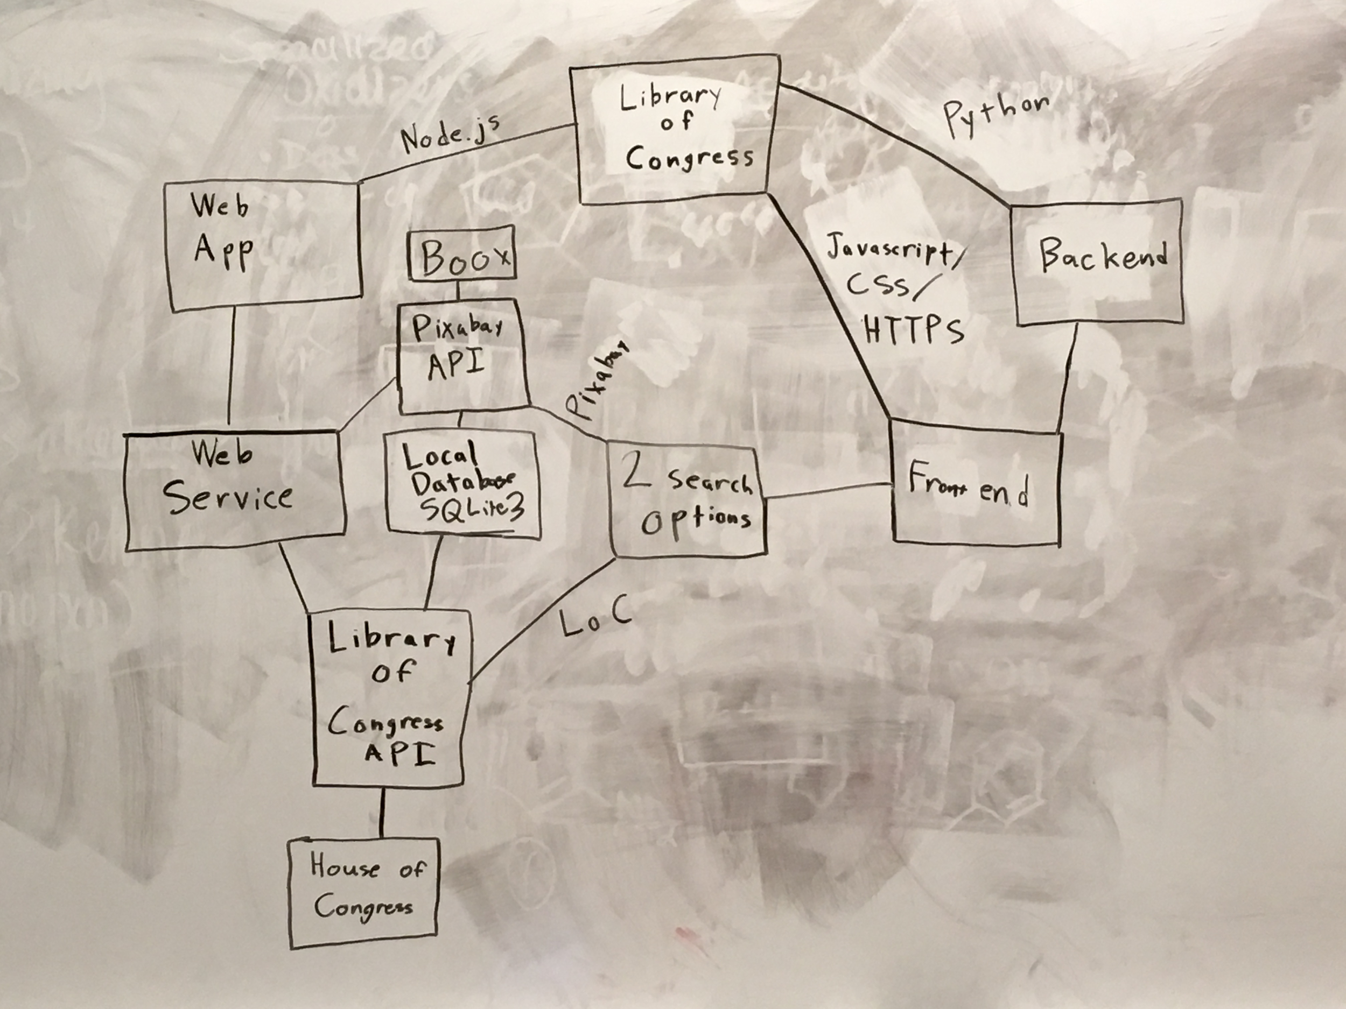
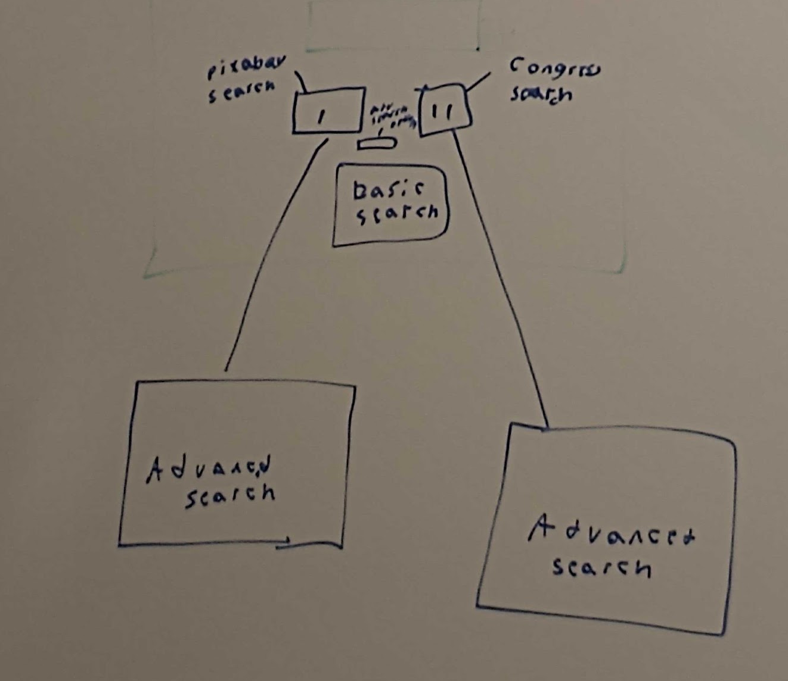
Conceptual model and Model Website

Slide 4
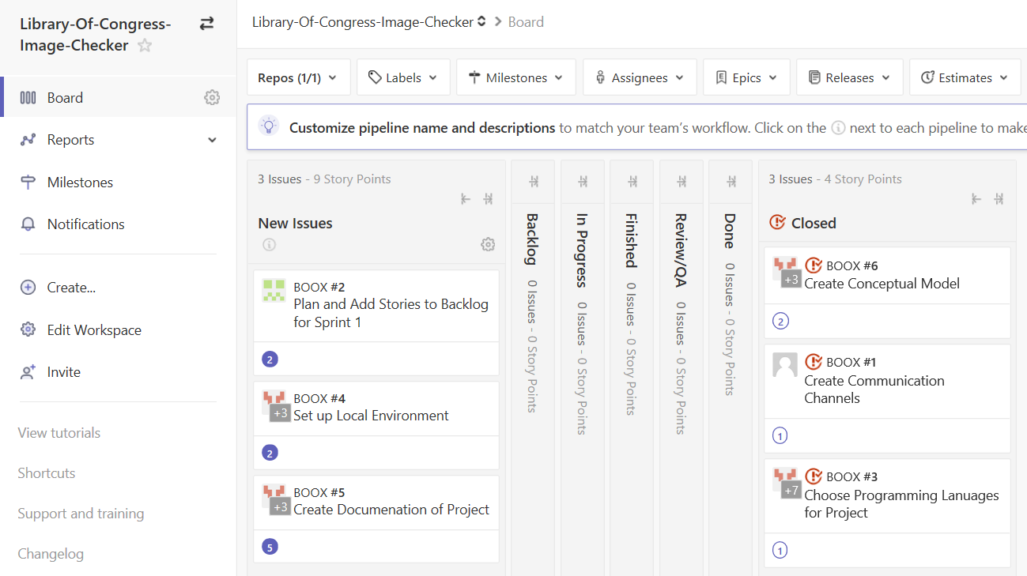
Stories

Slide 5
Project Challenges
Meeting with the group as a whole
Project managers and Scrum Master as priority
Discord ONLY for group calling
Seperate Databases
Each team will create their own database
Integrate into one

